Slide 1
Improving Language Understanding by Generative Pre-Training
Notes:
GPT-1 2018. Openai researchers.

Slide 2
Motivation
Most of the DL approaches require a substantial amount of labeled data.
The model can overcome the constraints of the small amount of annotated data for these specific tasks.
Unsupervised generative-pretraining (learning of word-level or phrase-level stats)
Supervised discriminative fine-tuning (supervised training using these-word level features)
Notes:
This actually restricts their applicability in many domains that suffer from the amount of annotated (unlabeled) data.

Slide 3
Generative Pre-Training (GPT)
Goal: Learn a universal representation that transfers with little adaptation to a wide range of tasks.
Two-stage training procedure:
Language modeling (LM) objective is used on the unlabeled data to learn the initial parameters of the model.
These parameters are then adapted to a target task using the corresponding supervised objective.
Transformer decoder is used as the underlying architecture.
Notes:
The paper assumes access to a large corpus of unlabeled text and several datasets with manually annotated training examples (the target tasks). The unlabeled corpus and the annotated datasets need not be in the same domain.
Transformers work better than LSTMs because they can capture long-term dependencies well. It’s also faster in training.
Furthermore, during the transfer, task-specific input adaptations are used which process the structured text input as a single contiguous sequence of tokens.

Slide 4
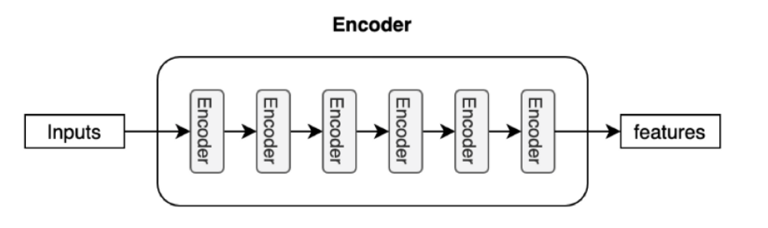
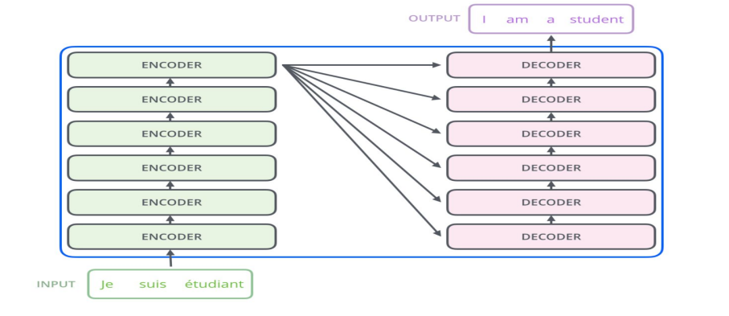
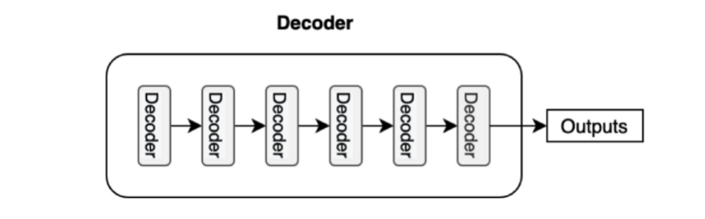
Transformer Architecture
Notes:
Before we get to dive into the GPT Framework, I will give brief information about transformers and self-attention.
The transformer uses an encoder-decoder architecture. The encoder extracts features from an input sentence, and the decoder uses the features to produce an output sentence (translation).
The encoder in the transformer consists of multiple encoder blocks. An input sentence goes through the encoder blocks, and the output of the last encoder block becomes the input features to the decoder.
The decoder also consists of multiple decoder blocks.
Each decoder block receives the features from the encoder.

Slide 5
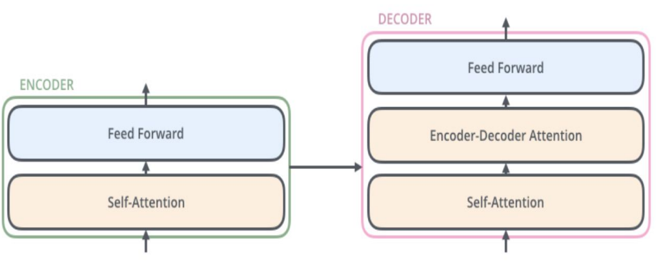
Transformer Encoder and Decoder
Notes:
The encoder block uses the self-attention mechanism to enrich each token (embedding vector) with contextual information from the whole sentence.
The position-wise feed-forward network (FFN) has a linear layer, ReLU, and another linear layer, which process each embedding vector independently with identical weights.
The encoder-decoder attention is another multi-head attention that calculates the attention values between the features (embeddings) from the input sentence and the features from the output (yet partial) sentence.

Slide 6
Self-Attention
Prepare inputs
Initialize weights
Derive key, query, and value
Calculate attention scores for Input 1
Calculate softmax
Multiply scores with values
Sum weighted values to get Output 1
Repeat steps 4–7 for Input 2 & Input 3

Slide 7
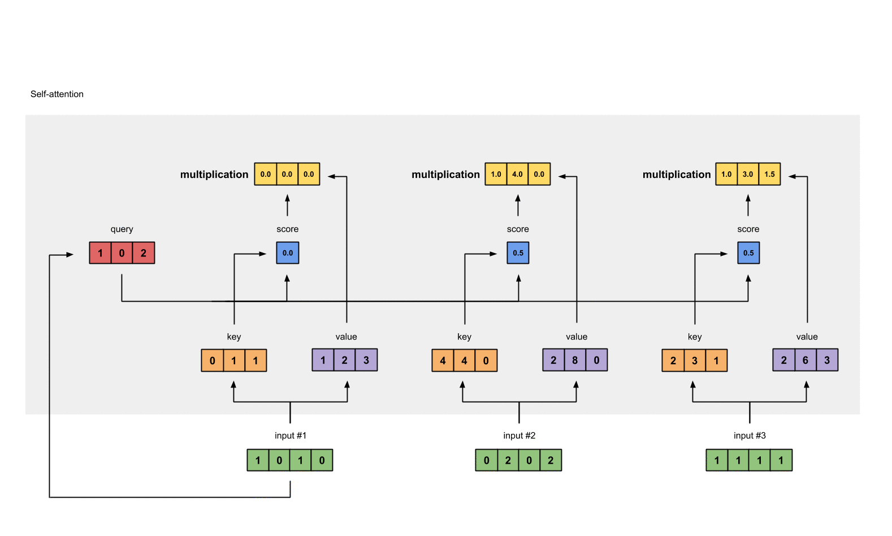
Self-Attention Illustration
Notes:
First step is preparing inputs
Second step is initializing key, query and value weights with random distribution.
Third step is deriving key, query and value representations for all the inputs by basically doing vector multiplication.
Obtaining attention scores by taking a dot product between individual input’s query with all keys.
Calculating softmax
Multiplying scores with values.
Sum weighted values to get Output for each input.

Slide 8
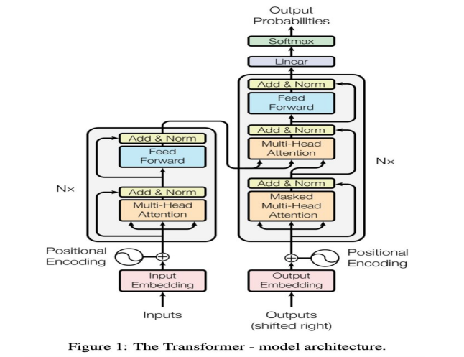
Transformer Architecture
GPT-1 uses the decoder part of the transformer.

Slide 9
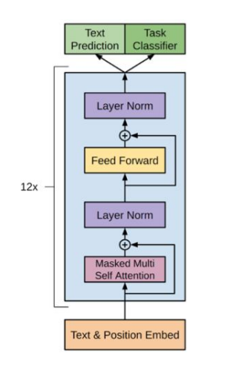
GPT Framework
The training procedure consists of two stages:
The first stage is learning a high-capacity language model (Unsupervised Pre-Training) on a large corpus of text.
This is followed by a (Supervised) fine-tuning stage, where the model is adapted to a discriminative task with labeled data.

Slide 10
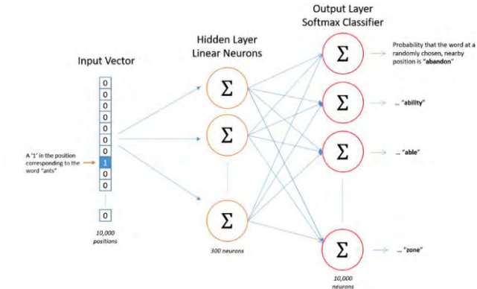
Embedding Algorithm (Skip-gram)
For each input word w(t), meaning a word in position t in an input sequence w, create a projection that predicts the neighboring words of w(t).
k -> window size.
Notes:
As we can see from this diagram, an input word is first converted into a one-hot vector.
This one hot vector is then fed into a single hidden layer. This hidden layer contains linear neurons, and its parameters will eventually become the parameters we would like to use to generate word embeddings.
then feed the output of this hidden layer to the output softmax classifier.
Then, we would use back propagation to train the parameters in one back pass for each particular set of input word and neighbors.
2.

Slide 11
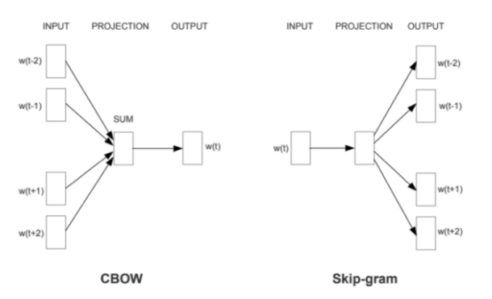
Embedding Algorithm (CBOW)
Instead of using the word w(t) to predict its neighbors, we use neighbors to predict w(t).

Slide 12
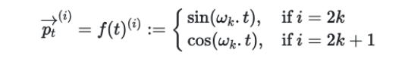
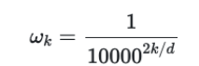
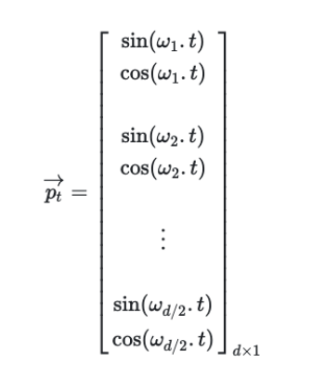
Positional Embedding
Accounts for the ordering information of the words in the input sequence.
Let 𝑡 be the desired position in the input sequence, and 𝑝𝑡 ⃗⃗⃗⃗ ∈ ℝ 𝑑 be its positional encoding, then the following function in the form 𝑓 ∶ ℕ → ℝ 𝑑 will give us the positional encoding.
Notes:
1. This is done by adding a positional encoding vector to every input embedding vector.
2. One common method of implementing positional encoding is through trigonometric functions.
3. This positional encoding is a vector where its element alternates between sine and cosine values

Slide 13
Layer Normalization
Layer normalization belongs to a class of normalization methods aimed to normalize the activities of neural networks so as to speed up training time and reduce the computational cost.
We calculate the mean and variance of each sample input and then normalize each sample such that the elements in the sample have zero mean and unit variance, and finally we linearly scale and shift the input with two learned parameters, bias, and gain.

Slide 14

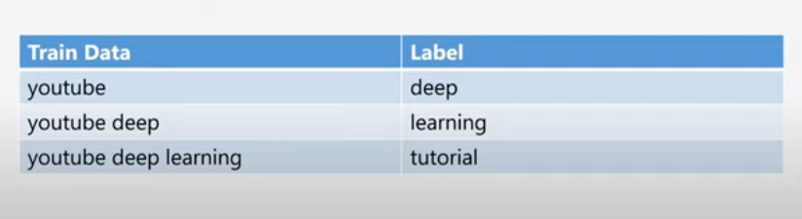
Language Model
Language Models predict the next token using given tokens.
Notes:
LM predicts these suggestions based on the given token “youtube deep”.

Slide 15
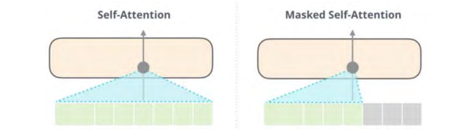
Decoder Only Architecture and Masked Self-Attention
Masked self-attention only allows a position to look at tokens to its left.
In other words, masked self-attention masks all the tokens in the future by setting the values in the respective vectors to negative infinity.
Notes:
1. I talked about GPT eliminates the encoder and directly feeds the input to the decoder’s stack.
2. The decoder is a variation of the encoder in terms of architecture. The main difference is that in decoders, instead of using the self-attention that we discussed, we use masked-self-attention.
3. Masked self-attention model could only look at words that already appeared in the input sequence for every given word.

Slide 16
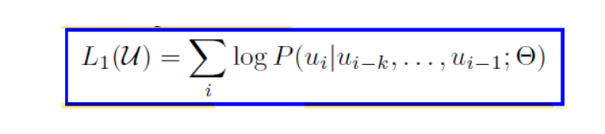
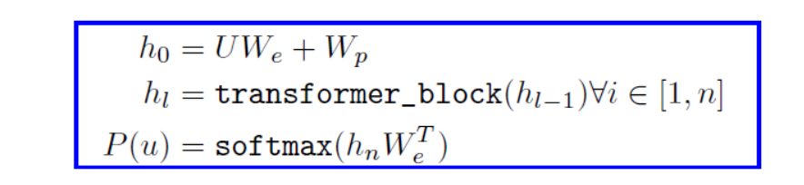
Unsupervised Pre-Training
U -> corpus of tokens (embedding vector)
k -> context window size
P -> Conditional probability (modeled using a network with parameters Θ.)
SGD is used to learn the parameters.
Notes:
A standard forward LM objective is used to maximize the likelihood.
2. The formula of the Likelihood is basically predicting the next word given previous words.
They’re basically trying the maximize the probability of choosing the correct next word.

Slide 17
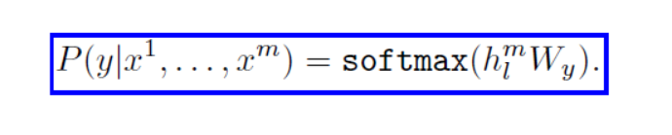
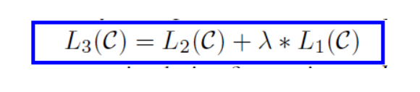
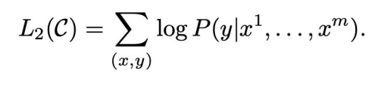
Supervised Fine-Tuning
Keep the pre-trained Transformers,
Replace the final linear layer,
Replace W_e with W_y,
Data inputs x, label y ,
Maximize
𝜆 is a weight factor.
Notes:
After the training of the model with optimization L₁, the parameters are now adapted to the supervised target task.
Formally, we are given a labeled dataset 𝐶, which consists of a sequence of input tokens, 𝑥 1 ,… , 𝑥 𝑚, and a label y.
The inputs are passed through our pre-trained model to obtain the final transformer block’s activation hlm which is then fed into ad added linear output layer with parameters 𝑊𝑦 to predict y, according to the conditional probability.
The researchers who proposed including language modeling as an auxiliary objective to this FT improves generalization and accelerates convergence. Specifically, the following objective was proposed to be optimized.

Slide 18
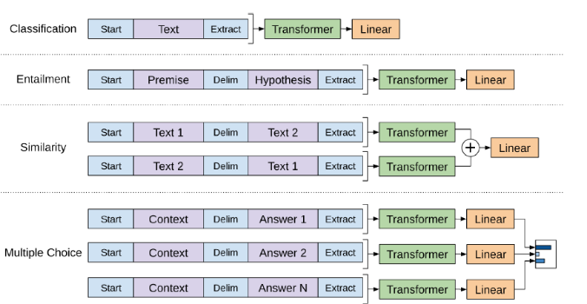
Task-Specific Input Transformations
Since the pre-trained model is trained on a contiguous sequence of texts, to handle the inputs of the various tasks, certain input transformations are needed.
A traversal-style approach is used where the structured inputs are converted into an ordered sequence that the pre-trained model can process.
Notes:
For some tasks, like text classification, we can directly fine-tune the model.
Certain other tasks, like question answering or textual entailment, have structured inputs such as ordered sentence pairs, or triplets of document, question, and answers.

Slide 19
Task-Specific Input Transformations
Textual Entailment - The premise (p) and the hypothesis (h) sequences are concatenated with a delimiter token in between.
Similarity - Since there is no inherent ordering of the two sequences being compared, the input sequence is modified to contain both possible sentence orderings. Each of these concatenated sequences is processed independently to produce two sequence representations h_{l}^{m} which are then element-wise added before feeding to the linear output layer.
Question Answering - The document and question are concatenated with each of the possible answers. Each of these sequences is processed independently by the model and then normalized by a softmax layer to produce an output distribution over possible answers.
Notes:
Similarity -> Each of these concatenated sequences is processed independently to produce two sequence representations h_{l}^{m} which are then element-wise added before feeding to the linear output layer.

Slide 20
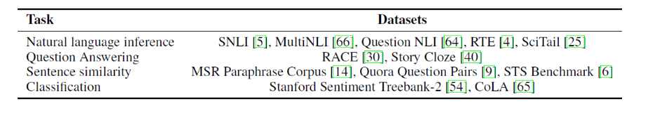
Experiments (Unsupervised Pre-Training)
BookCorpus dataset was used for training the language model.
Contains long stretches of contiguous text,
Over 7000 unique unpublished books.
Word Benchmark, ELMo.

Slide 21
Model Specifications
12-layer decoder-only transformer with masked self-attention heads (768 dim. States and 12 attention heads).
For the position-wise-feed-forward networks, 3072 dim. inner states are used.
Adam optimization with max. learning rate of 2.5e-4.
100 epochs n mini-batches of 64 randomly sampled, contiguous sequences of 512 tokens.
Bytepair encoding vocabulary with 40.000 merges.
L2 regularization with w = 0.01.
Gaussian Error Linear Unit (GELU) for the activation function.
ftfy library to clean the raw text.
spaCy tokenizer.

Slide 22
Fine-tuning Details
Hyperparameter settings from unsupervised pre-training are used.
Dropout with a rate of 0.1 is added to the classifier.
Learning rate of 6.25e-5 and batch size of 32 is used.
Linear learning rate decay schedule with warmup over 0.2% of training is used.
λ was set to 0.5.

Slide 23
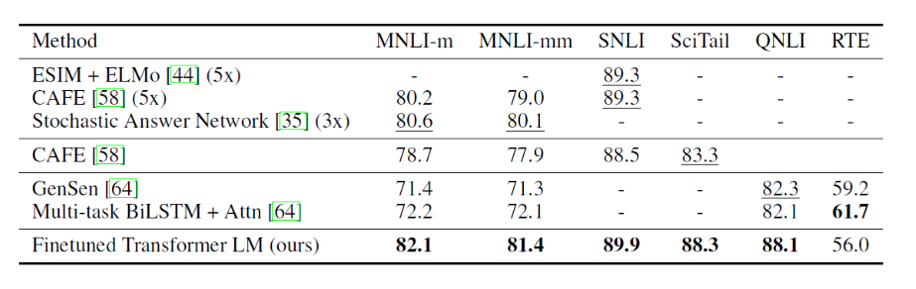
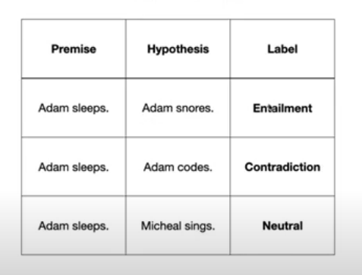
Supervised Fine-Tuning
Natural Language Inference – Involves reading a pair of sentences and judging the relationship between them from one of entailment, contradiction, or neutral.
5x indicates an ensemble of 5 models.
Accuracy is the metric.
Notes:
It is also known as textual entailment.
Proposed Method significantly outperforms the baselines on four of the five datasets.
This demonstrates the models’ ability to better reason over multiple sentences and handle aspects of linguistic ambiguity.
Authors mentioned that the last dataset being below 61.7 as their model will benefit multi-task training as well but not have explored this currently.

Slide 24
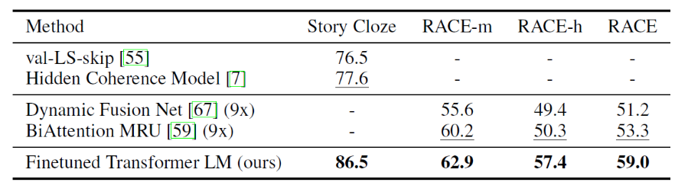
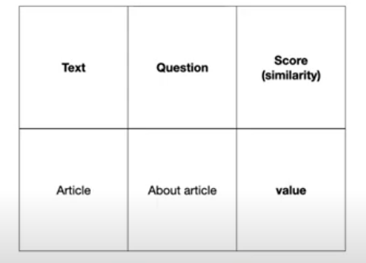
Supervised Fine-Tuning
Question Answering and Commonsense Reasoning - The RACE dataset (passages with associated questions from middle and high school exams) and Story Cloze dataset (selecting the correct ending to multi-sentence stories from two options) were used. The model outperformed the baseline on both of these datasets.

Slide 25
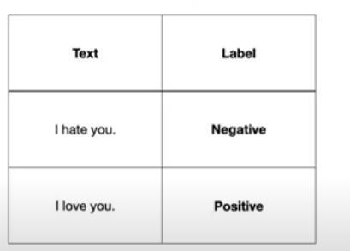
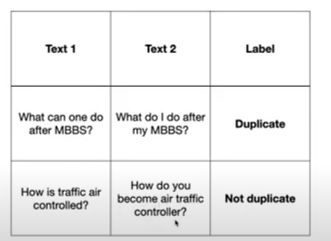
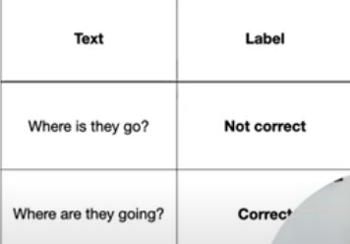
Supervised Fine-Tuning
Semantic Similarity - The challenges in this task are recognizing rephrasing, negation, and handling ambiguity. The model performs better on 2 (QQP and STS-B) of the 3 datasets.
Classification - The model performs better on both Corpus of Linguistic Acceptability (CoLA) datasets and is at par with the state-of-the-art results on the Stanford Sentiment Treebank dataset.

Slide 26
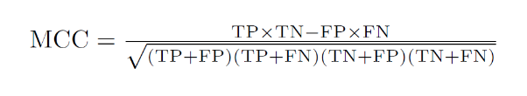
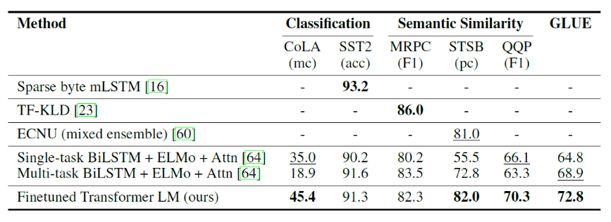
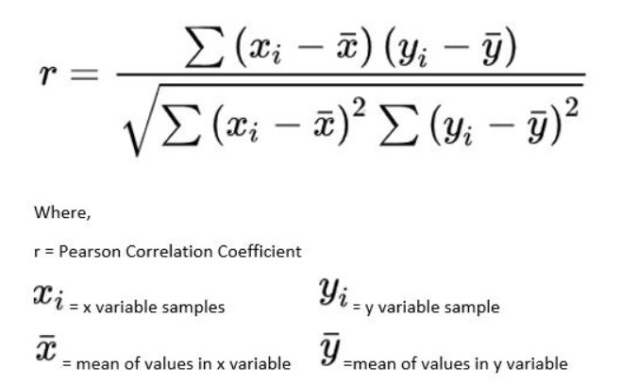
mc -> Matthews correlation
acc -> Accuracy
pc -> Pearson correlation
Notes:
1. In overall, the proposed approach achieves new state-of-the-art results in 9 out of 12 datasets. Also works well across datasets of different sizes.

Slide 27
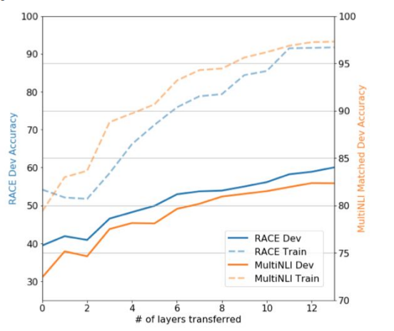
Number of Layers Transferred - Analysis
More the number of layers that are transferred from the pretrained model to the supervised target task, the better is the performance on the target tasks.

Slide 28
Zero-Shot Performance on Different Tasks
Series of heuristic solutions designed.
For CoLA (linguistic acceptability), examples are scored as the average token log-probability the generative model assigns and predictions are made by thresholding.
For SST-2 (sentiment analysis), they append the token “very” to each example and restrict the model’s output distribution to only the words “positive” and “negative” and guess the token it assigns higher probability to as the prediction.
For RACE (question answering), they pick the answer the generative model assigns the highest average token log-probability when conditioned on the document and question.
For DPRD (winograd schemas), they replace the definition pronoun with the two possible referents and predict the resolution that the generative models assign higher average token log-probability to the rest of the seq. after the substitution.
Notes:
Zero-shot behavior: in zero-shot, no demonstration is allowed, and as a result, the model is directly given a natural language instruction for the task.
Winograd schema:Designed to be an improvement on the Turing test, it is a multiple-choice test that employs questions of a very specific structure: they are instances of what are called Winograd schemas, named after Terry Winograd

Slide 29
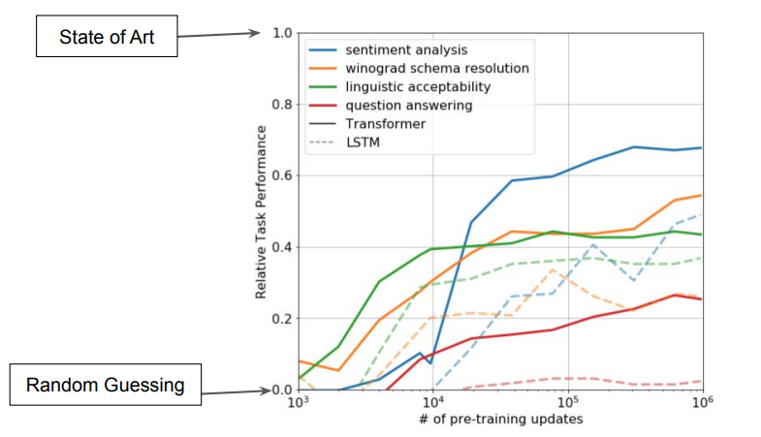
Zero-Shot Performance on Different Tasks
Performance of these heuristics is stable and steadily increases over training.
LSTM exhibits higher variance in its zero-shot performance.
Notes:
This shows that generative pretraining supports the learning of a wide variety of task-relevant functionality.

Slide 30
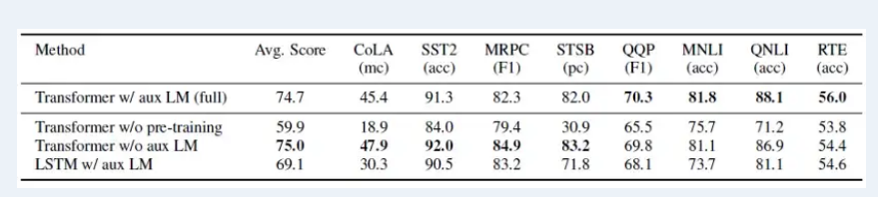
Ablation Studies
Three different ablation studies performed:
Without the auxiliary LM objective during fine-tuning.
Effect of the transformer analyzed by comparing it with a single layer 2048 unit LSTM using the same framework.
They also compare with their transformer architecture directly trained on supervised target tasks, without pre-training.
Notes:
An ablation study investigates the performance of an AI system by removing certain components to understand the contribution of the component to the overall system.
Observed that auxiliary objective helps on the NLI tasks and QQP (quora question pairs). Larger datasets benefit from the auxiliary objective, smallers are not.
They observe a 5.6 average score drop when using the LSTM instead of the transformer. The LSTM only outperforms the Transformer on one dataset MRPC.
They observe that the lack of pre-training decreases performance across all the tasks, compared to the full model, performance 14.8% decreases.

